Slide 1
Sports Teams Named After Ethnic Groups
By: Myrrakal S. Crawley

Slide 2
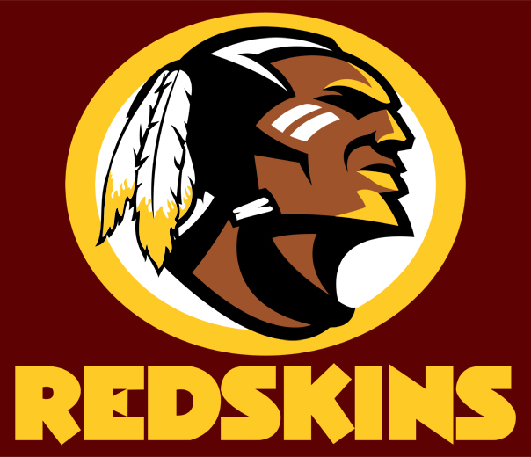
Logo for the Washington Redskins
NFL

Slide 3
Logo for the Kansas City Chiefs
NFL

Slide 4
Logo for the Cleveland Indians
MLB

